Slide 1
Fine-Tuning LLMs

Slide 2
Overview & Learning Objectives
Recap of transformer and architecture fundamentals.
Today’s focus: applying transfer learning to fine-tune DistilBERT.
Key topics:
Transfer Learning in NLP.
Data preparation & tokenization.
Fine-tuning process using Hugging Face Trainer API.
Brief overview of evaluation metrics (precision, recall, F1-score).

Slide 3
Transfer Learning: Adapting a Pre-Trained Model
Why Transfer Learning?
  Leverages vast knowledge from pre-training on large corpora.
  Requires fewer task-specific data and less training time.
DistilBERT as a Case Study:
  A distilled version of BERT: 40% smaller, 60% faster with comparable performance.
  Ideal for resource-efficient fine-tuning.
Real-World Example:
Applications such as sentiment analysis, spam detection, and question-answering systems benefit from this approach.

Slide 4
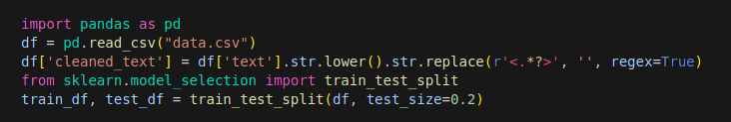
Data Preparation & Preprocessing
Dataset Requirements:
  Ensure high-quality, task-specific labeled data.
  Example: Use a text classification dataset (e.g., sentiment analysis or multi-class categorization).
Data Cleaning Steps:
  Lowercasing, removing HTML tags, URLs, and special characters.
  Handling missing or inconsistent labels.
Splitting Data:
  Divide into training, validation, and test subsets.

Slide 5
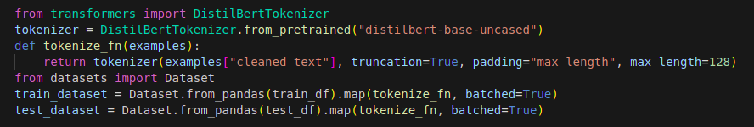
Tokenization Using Hugging Face Tools
Tokenizer Selection:
Use DistilBertTokenizer from Hugging Face for text inputs.
Tokenizing the Text:
Convert cleaned text data into token IDs.
Ensure sequences are truncated (or padded) to the model's maximum length.
Dataset Conversion:
Convert the Pandas DataFrame into a Hugging Face Dataset object.
Map a tokenization function in batched mode.

Slide 6
Configuring the Fine-Tuning Process
Loading the Model:
  Use DistilBertForSequenceClassification for classification tasks.
  Specify num_labels according to the task (binary, multi-class, etc.).
Training Arguments:
  Define parameters: learning rate, batch size, number of epochs, etc.
  Set up evaluation strategies (e.g., evaluation at each epoch).
Creating Trainer Instance:
  Combine the model, tokenizer, dataset, and data collator.

Slide 7
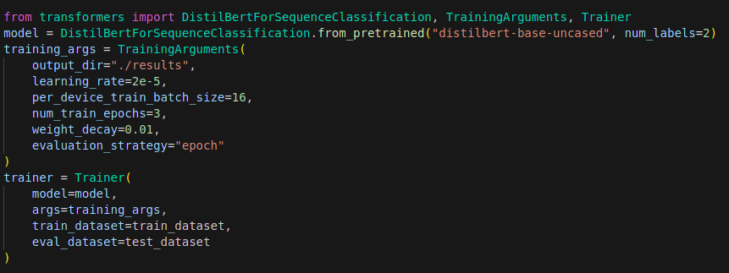
Example

Slide 8
What to Expect During Fine-Tuning
Training Dynamics:
Model adapts pre-trained weights to task-specific nuances.
Monitor loss and accuracy trends to detect convergence or overfitting.
Evaluation Metrics:
Focus on accuracy, precision, recall, and F1-score.
Use validation data to assess model improvements at each epoch.
Expected Performance:
DistilBERT, fine-tuned on a properly prepared dataset, can achieve competitive performance even on smaller tasks.
Share anecdotal insights or typical metrics (e.g., 85%+ accuracy on sentiment tasks) as benchmarks.

Slide 9
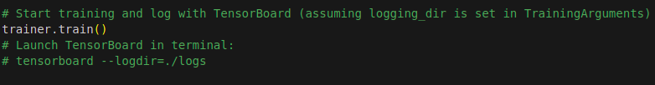
Training Execution & Monitoring
Launch the Training Process:
Use the Trainer API’s trainer.train() to start fine-tuning.
Emphasize iterations/epochs and expected runtime.
Monitoring Tools:
TensorBoard: For real-time visualization of loss, accuracy, and other metrics.
Weights & Biases (W&B): For advanced experiment tracking.
Key Metrics to Watch:
Training loss, validation loss.
Accuracy trends and any early signs of overfitting.

Slide 10
Saving and Deploying Your Fine-Tuned Model
Saving the Model:
Use Hugging Face’s model.save_pretrained() and tokenizer.save_pretrained().
Discuss versioning and model registry practices.
Deployment Options:
Local API deployment using Flask or FastAPI.
Cloud deployment via Hugging Face Inference API, AWS SageMaker, or Azure ML.
Inference Pipeline:
Outline how to load the saved model for predictions.
Example use case: classify incoming text in a production environment.

Slide 11
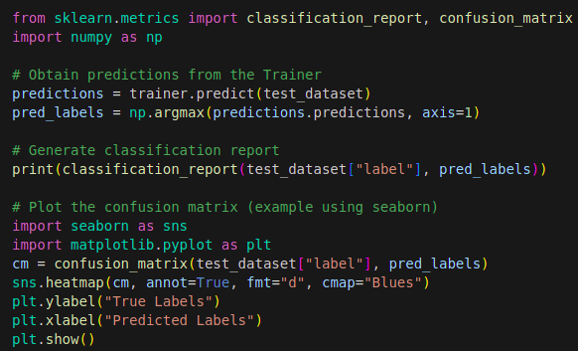
Model Evaluation & Metrics
Evaluation Approach:
  Use the test dataset to generate predictions.
  Compute standard metrics: accuracy, precision, recall, and F1-score.
Generating a Classification Report:
  Leverage libraries such as scikit-learn for detailed performance analysis.
Visualizing Performance:
  Create a confusion matrix to pinpoint misclassification patterns.

Slide 12
Error Analysis and Iterative Refinement
Identifying Errors:
Look at examples where the model’s predictions differ from true labels.
Analyze whether misclassified cases share common patterns (e.g., ambiguous phrasing or domain-specific jargon).
Strategies for Improvement:
Increase training epochs or adjust the learning rate.
Augment the training dataset with additional, domain-specific data if necessary.
Use Cases:
Adjust model strategies if minority classes are under-predicted.
What are some reasons your model might consistently err on one category?

Slide 13
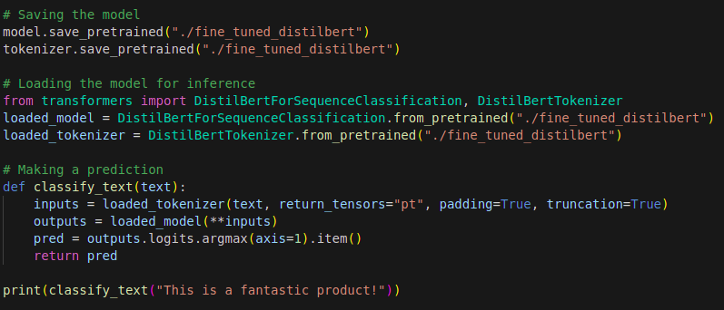
Saving and Deploying Your Fine-Tuned Model

Slide 14
Comparative Analysis: Precision, Recall & F1
Key Metrics Recap:
Precision: Measures correctness of positive predictions.
Recall: Measures the ability to capture all positive samples.
F1-score: The harmonic mean of precision and recall.
Benchmarking:
Compare baseline performance (pre-fine-tuning) versus post-fine-tuning performance.
Discuss expected ranges based on similar projects.
Discussion Points:
How these metrics impact the end application.
Trade-offs between precision and recall in different contexts (e.g., high recall for QA, high precision for spam filtering).

Slide 15
Full Fine-Tuning vs. Parameter-Efficient Fine-Tuning
The Fine-Tuning Spectrum:
  Full fine-tuning updates every parameter in the pre-trained model.
  Parameter-Efficient Fine-Tuning (PEFT) freezes the base model and trains only a small set of added parameters.
Why PEFT Emerged:
  Modern LLMs have hundreds of millions to billions of parameters, so full fine-tuning demands large GPU memory and a full model copy per task.
  Methods like LoRA train under 1% of parameters while recovering most of full fine-tuning's performance.
Today's Focus:
  Compare how full fine-tuning and LoRA/PEFT differ, and when to reach for each approach.

Slide 16
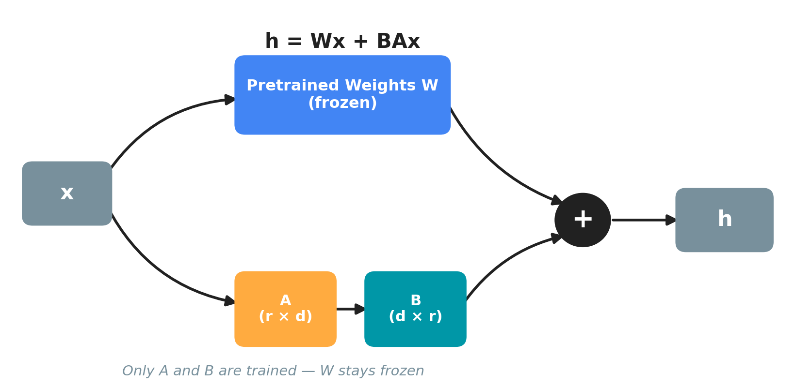
How LoRA Works: Low-Rank Adaptation
Core Idea:
  Freeze the pre-trained weights W and learn a small update ΔW = B×A instead of touching W directly.
The Math:
  Output becomes h = Wx + BAx, where B and A are low-rank matrices with rank r much smaller than model dimension d.
Why It's Efficient:
  Rank r is typically 4–64, so only B and A are trained — a tiny fraction of W's size.

Slide 17
The PEFT Family: Beyond LoRA
Adapter Layers:
  Insert small trainable feed-forward modules between transformer layers; the base model stays frozen.
Prefix / Prompt Tuning:
  Learn continuous task-specific vectors prepended to the input instead of touching model weights.
QLoRA:
  Combines LoRA with 4-bit quantization of the base model for extreme memory savings on a single GPU.
Where LoRA Fits:
  The most widely adopted PEFT method — simple to implement, adds no extra inference latency, and performs consistently well.

Slide 18
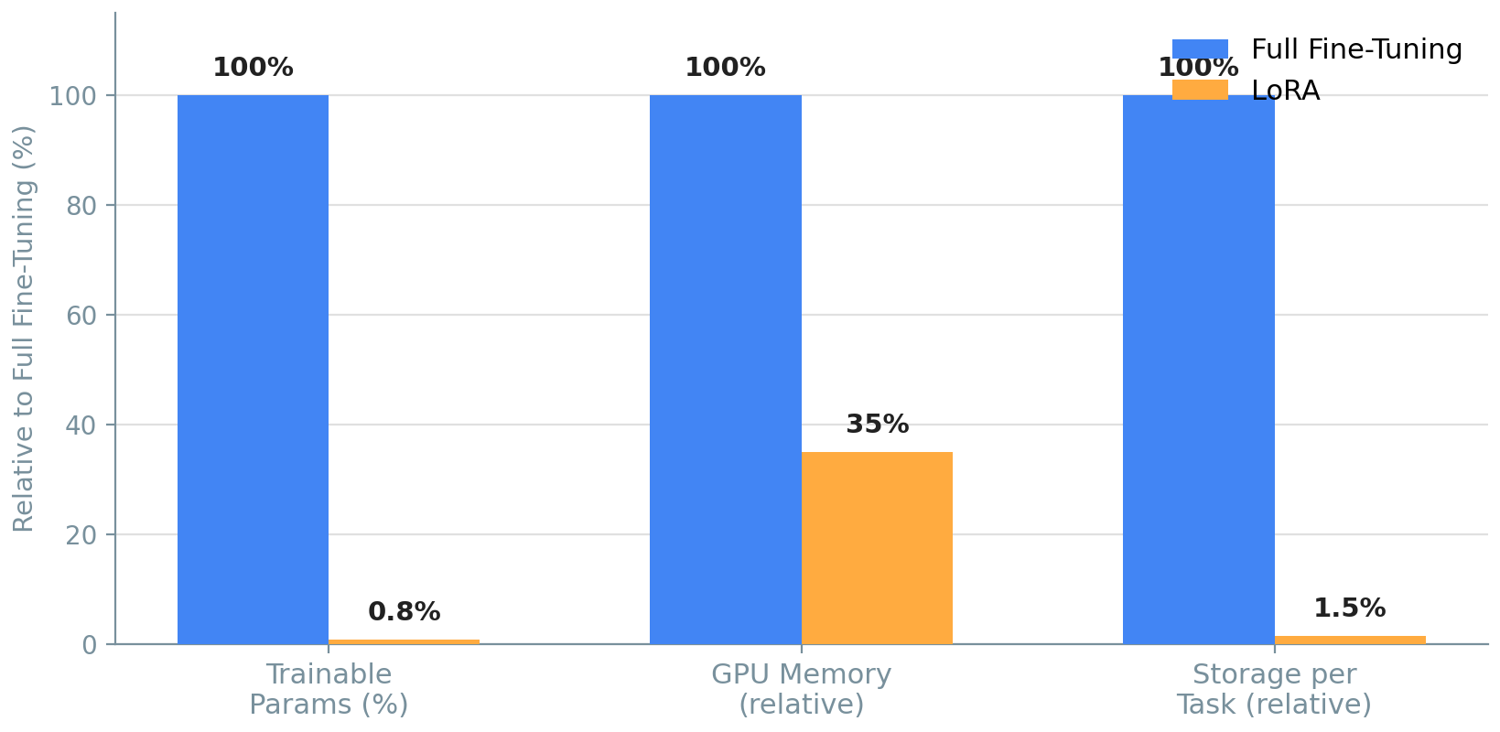
Full Fine-Tuning vs. LoRA: Head-to-Head
Trainable Parameters:
  Full fine-tuning updates ~100% of weights; LoRA typically updates under 1%.
Memory & Storage:
  LoRA needs far less optimizer memory and only megabytes of storage per task, versus a full model copy for full fine-tuning.
Speed & Performance:
  LoRA trains faster per step and typically lands within 1–2% of full fine-tuning accuracy on most tasks.

Slide 19
Choosing the Right Approach
Choose Full Fine-Tuning When:
  You have ample compute and need maximum performance on one well-resourced task.
  The target domain is very different from the pre-training data and needs deep weight changes.
Choose LoRA/PEFT When:
  You need to serve many task-specific variants of the same base model cheaply.
  Compute, memory, or storage budget is limited — including single consumer-GPU setups.
Applied to This Course:
  Our DistilBERT walkthrough uses full fine-tuning for clarity, but the same Trainer API workflow extends directly to LoRA via Hugging Face's PEFT library.

Slide 20
Wrap-Up & Q&A
Recap:
Importance of data preprocessing and tokenization.
Setting up the Trainer API and monitoring the fine-tuning process.
Evaluating the model using classification reports and confusion matrices.
Steps toward deploying and maintaining a fine-tuned model.

